Slide 1

The Atomic Human
Understanding Ourselves in the Age of AI
Neil D. Lawrence

Slide 2


Slide 4

Notes:
The Diving Bell and the Butterfly](https://www.penguinrandomhouse.com/books/9616/the-diving-bell-and-the-butterfly-by-jean-dominique-bauby/) is the autobiography of Jean Dominique Bauby. Jean Dominique was the editor of the French Elle magazine, in 1995 at the age of 43, he suffered a major stroke. The stroke paralyzed him and rendered him speechless. He was only able to blink his left eyelid, he became a sufferer of locked in syndrome.

Slide 5
E S A R I N T U L
O M D P C F B V
H G J Q Z Y X K W

Slide 6
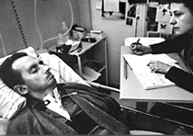
bits/minute
6
2000
billions
a billion
billion
a billion
billion
calculations/s
trillions
5 trillion
years
15 billion
years
20
minutes
embodiment

Slide 7
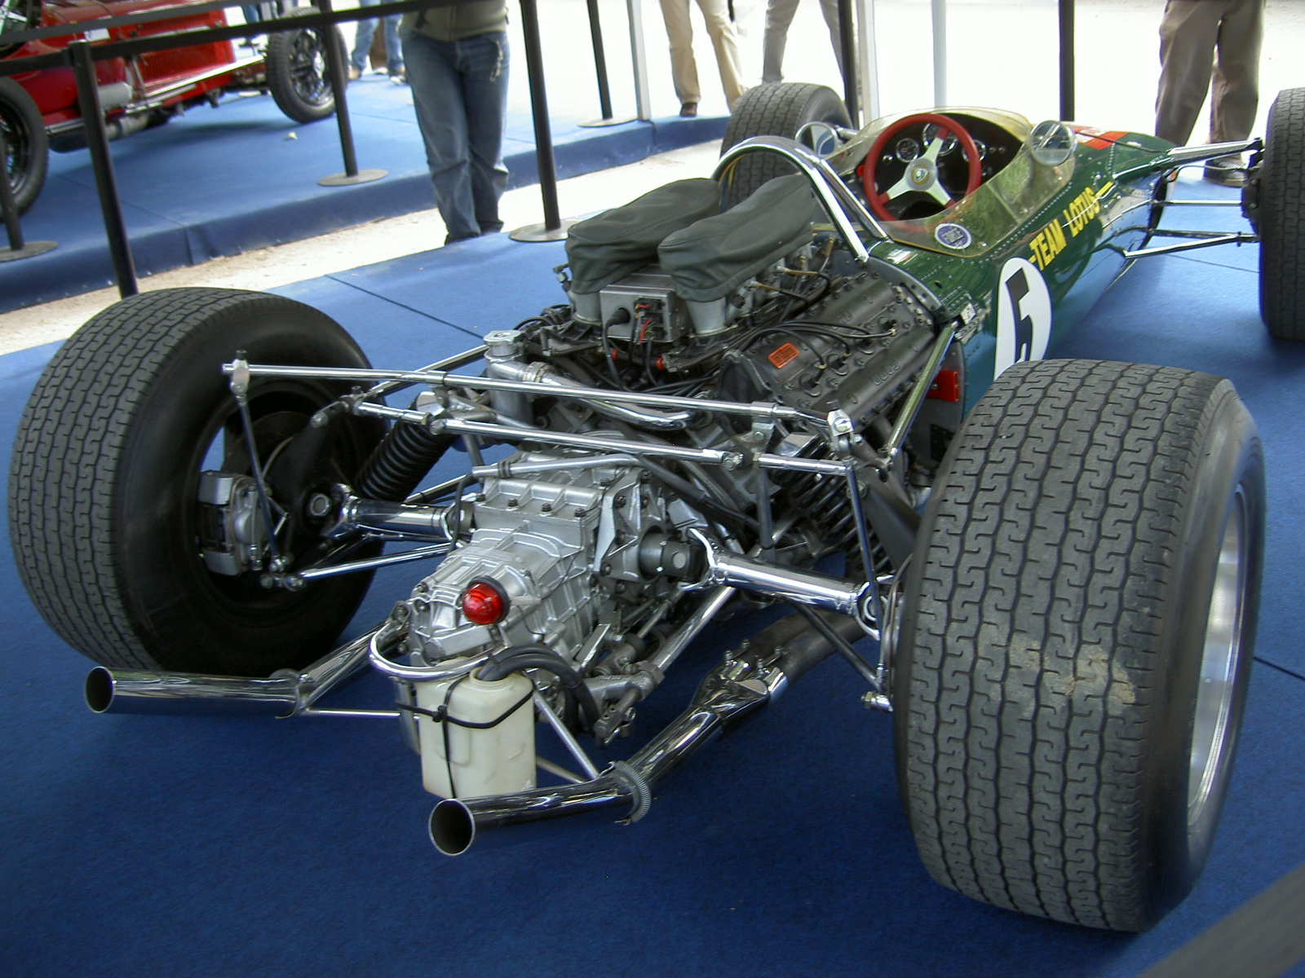
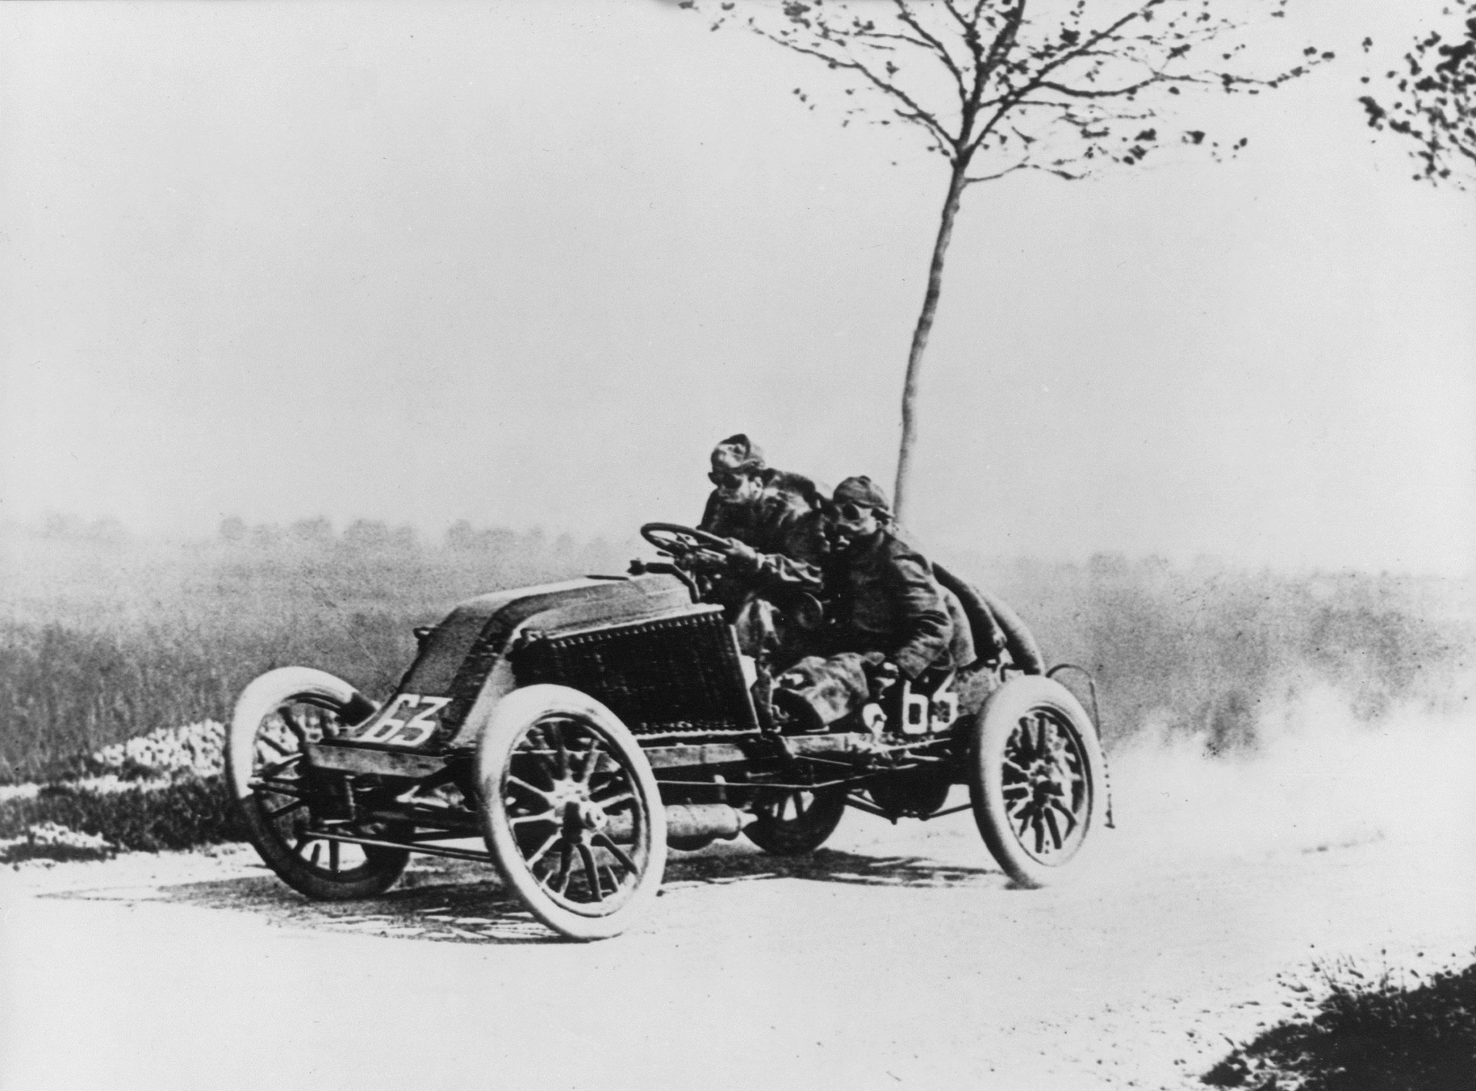

Notes:
Lotus 49, Marcel Renault and Caleb McDuff

Slide 8
?
!#@%&?
#
!
&
!
£*?$&!
&
?
#

Slide 9
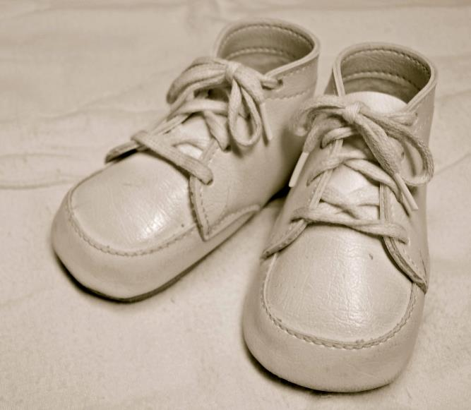
For Sale, Baby Shoes, Never Worn

Slide 10
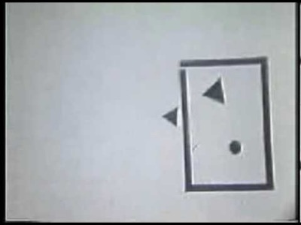
Notes:
Fritz Heider and Mariane Simmel produced this video for a 1944 paper https://psycnet.apa.org/record/1945-01435-001d

Slide 11
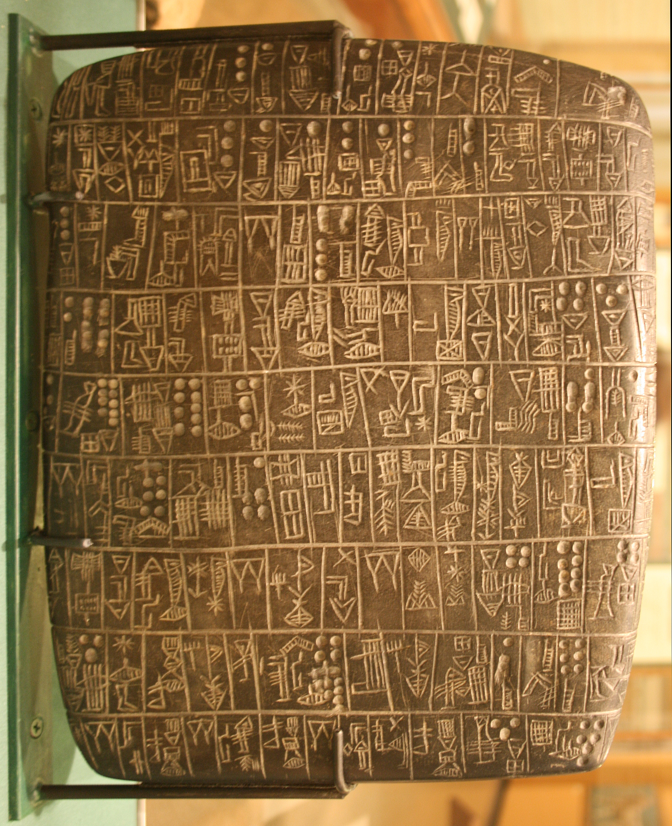
Notes:
Chicago Stone, side 2, recording sale of a number of fields, probably from Isin, Early Dynastic Period, c. 2600 BC, black basalt

Slide 12


Slide 13
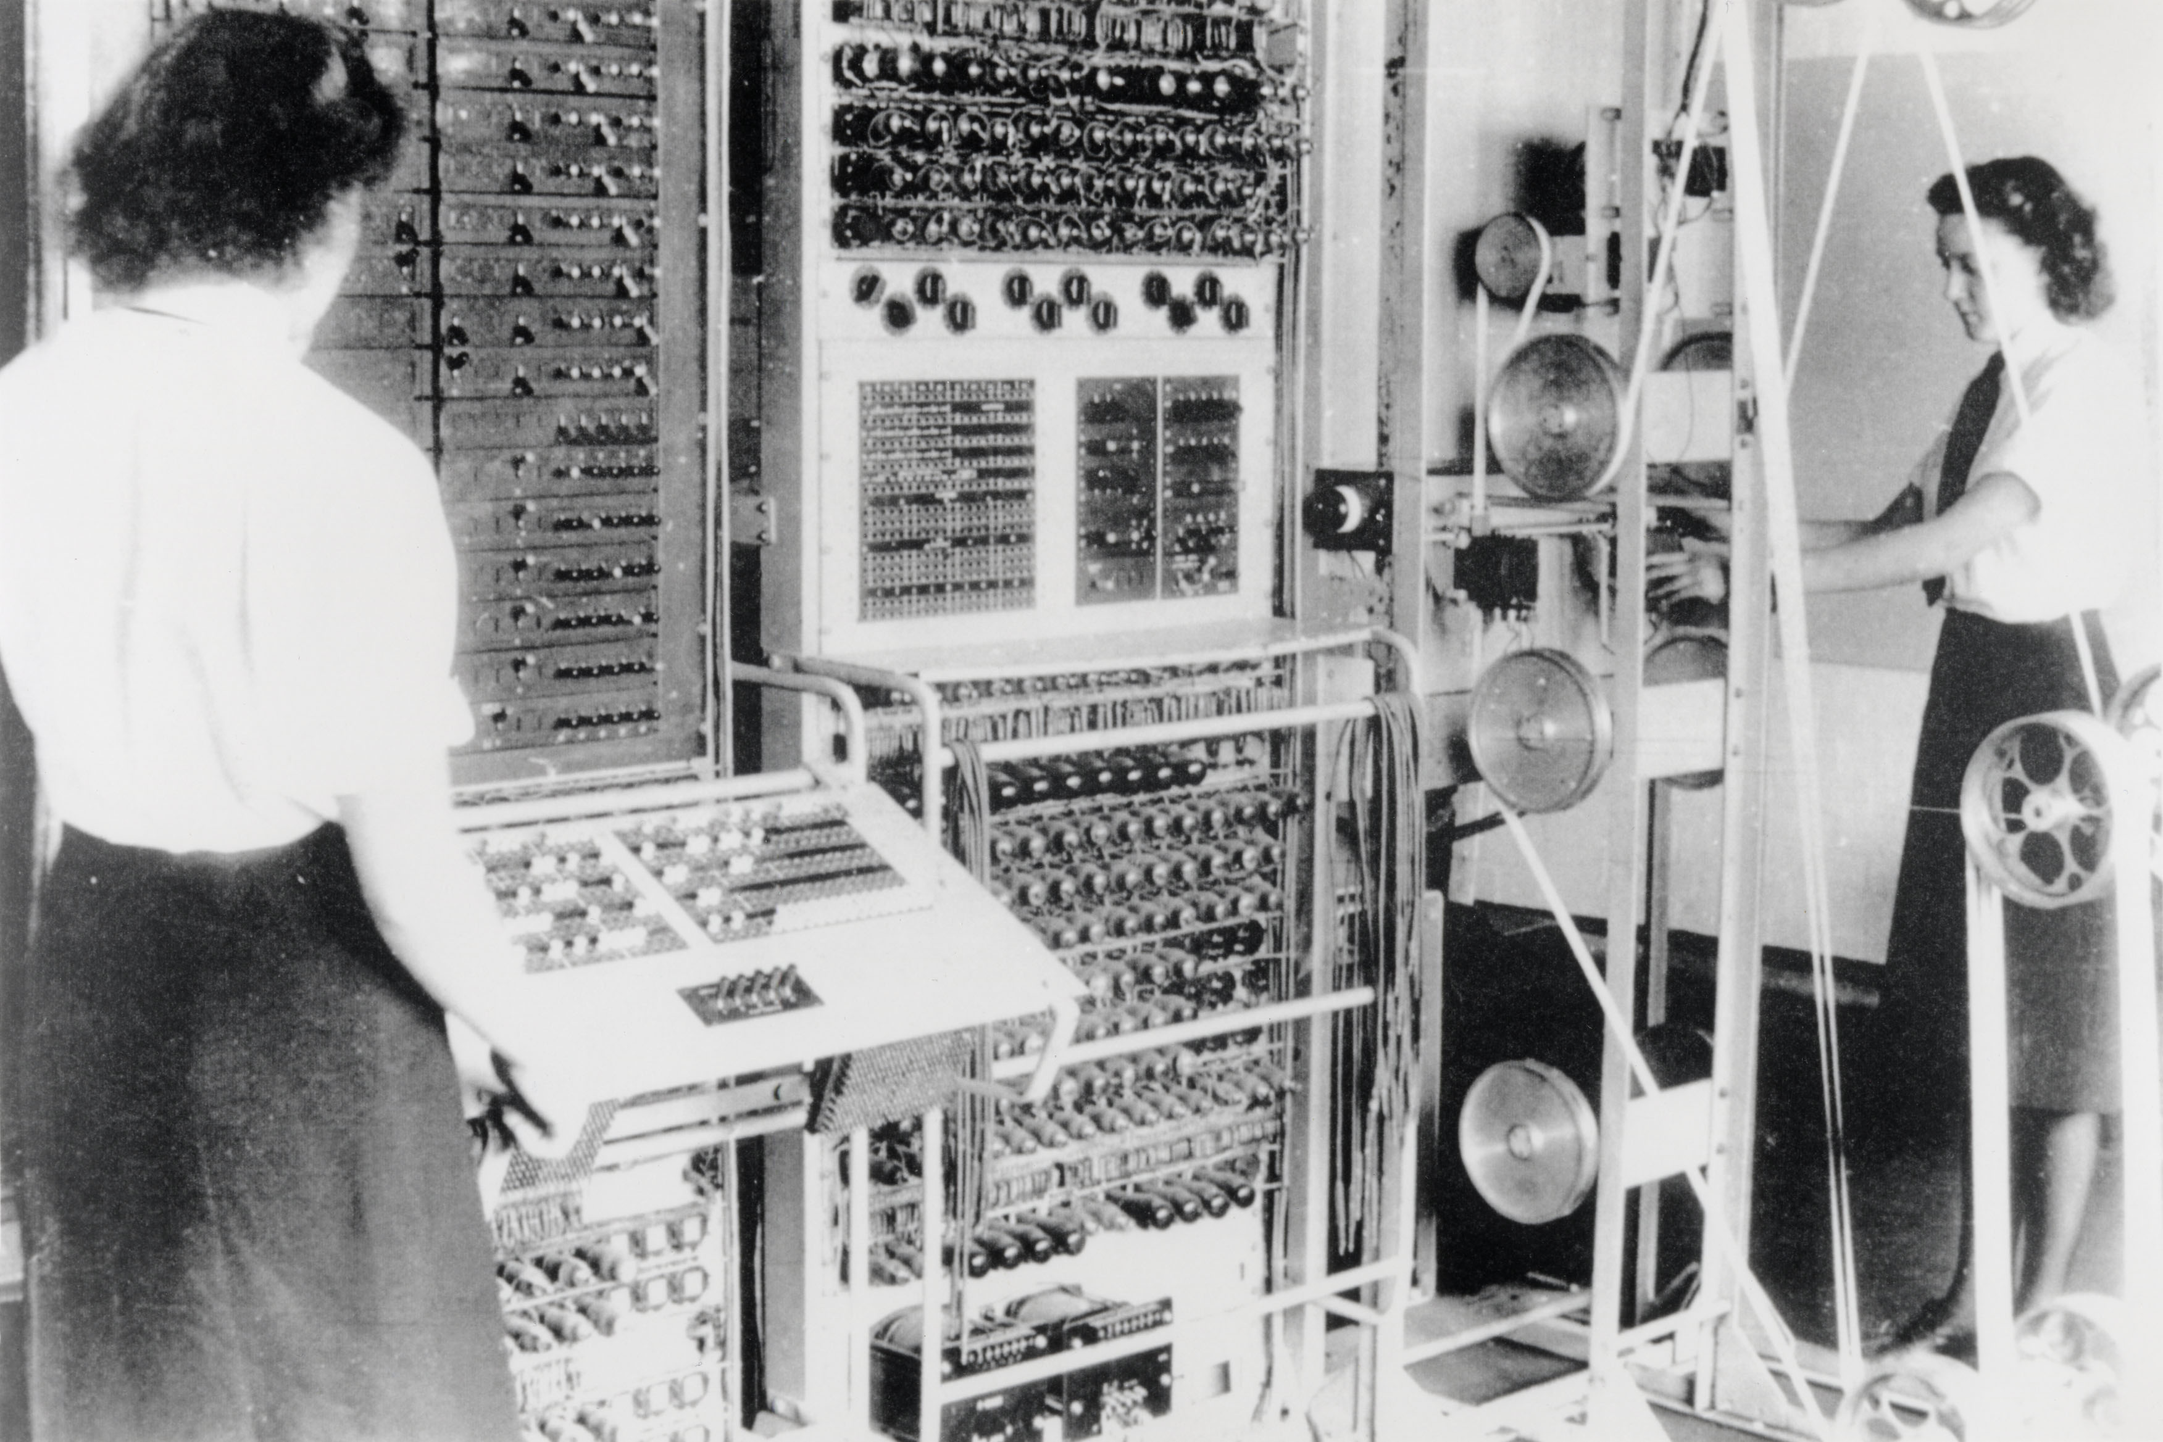
Notes:
A mark 2 colossus based at Bletchley Park being operated by Dorothy Du Boisson (left) and Elsie Booker (right)

Slide 14
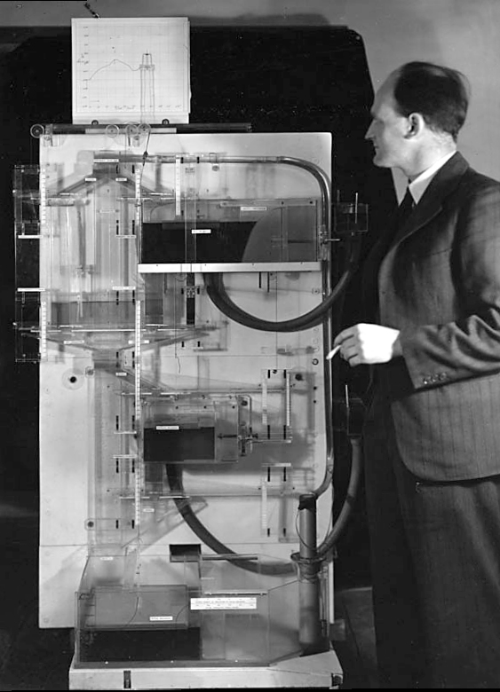
Notes:
Bill Phillips standing next to the MONIAC (completed in 1949)

Slide 16


Slide 17
complexity
bandwidth

Slide 18







Slide 19

Available from 6th June 2024
Thanks!

